Slide 1


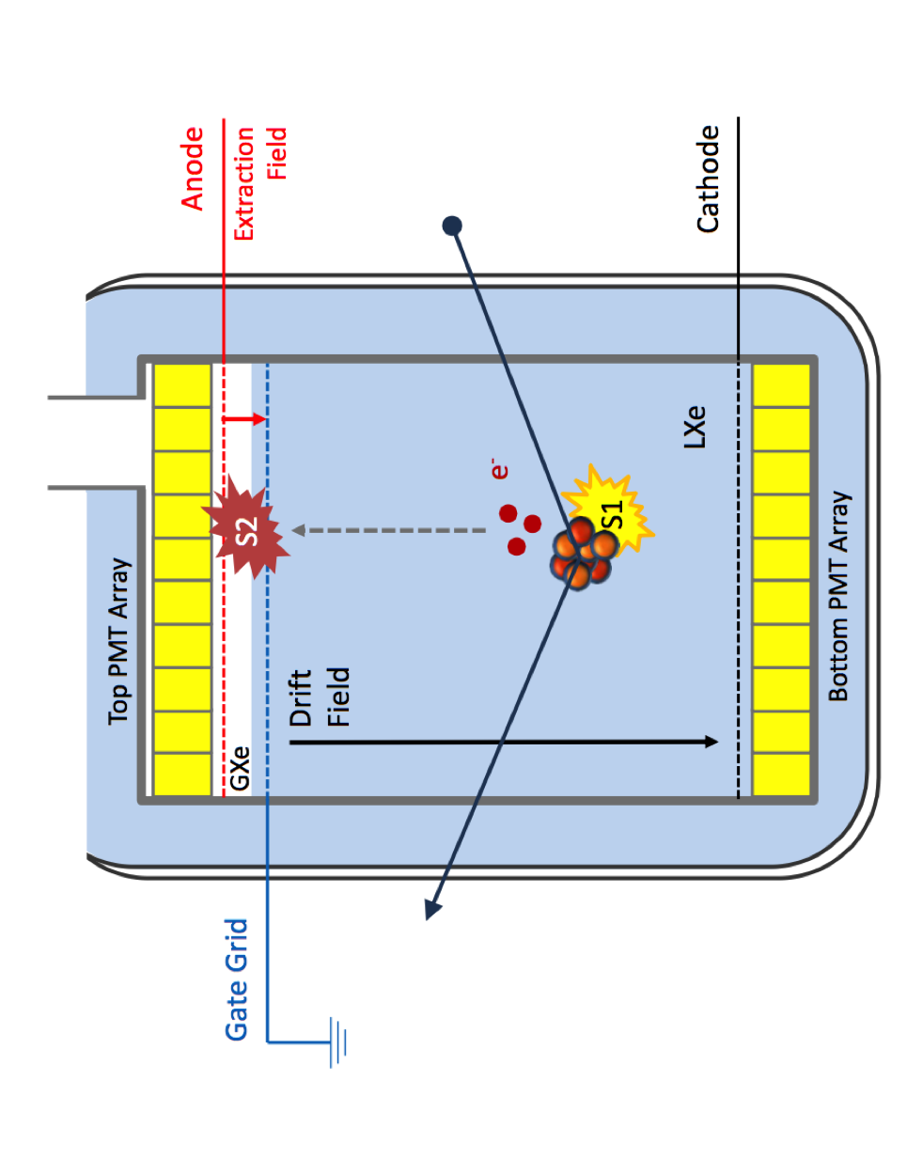
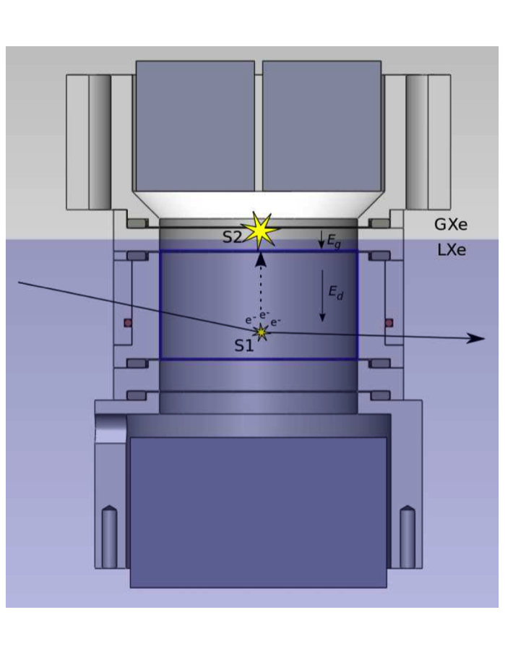
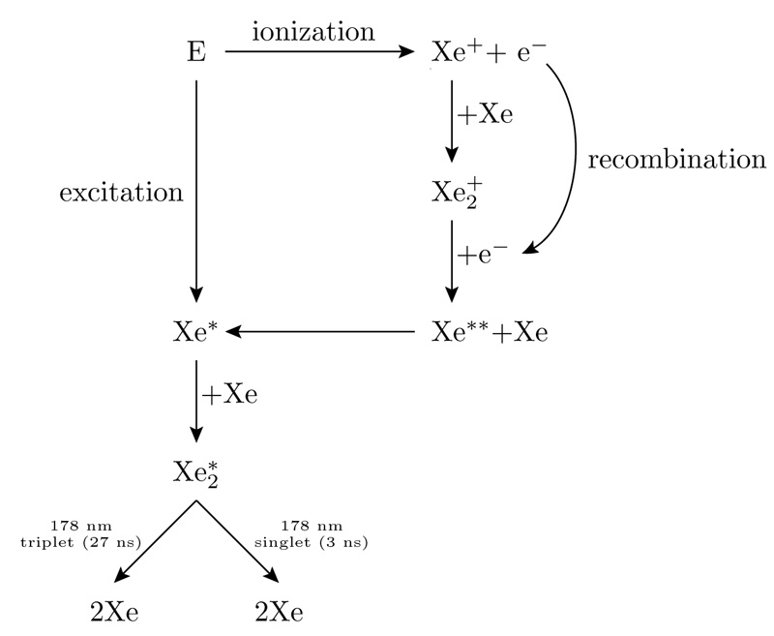
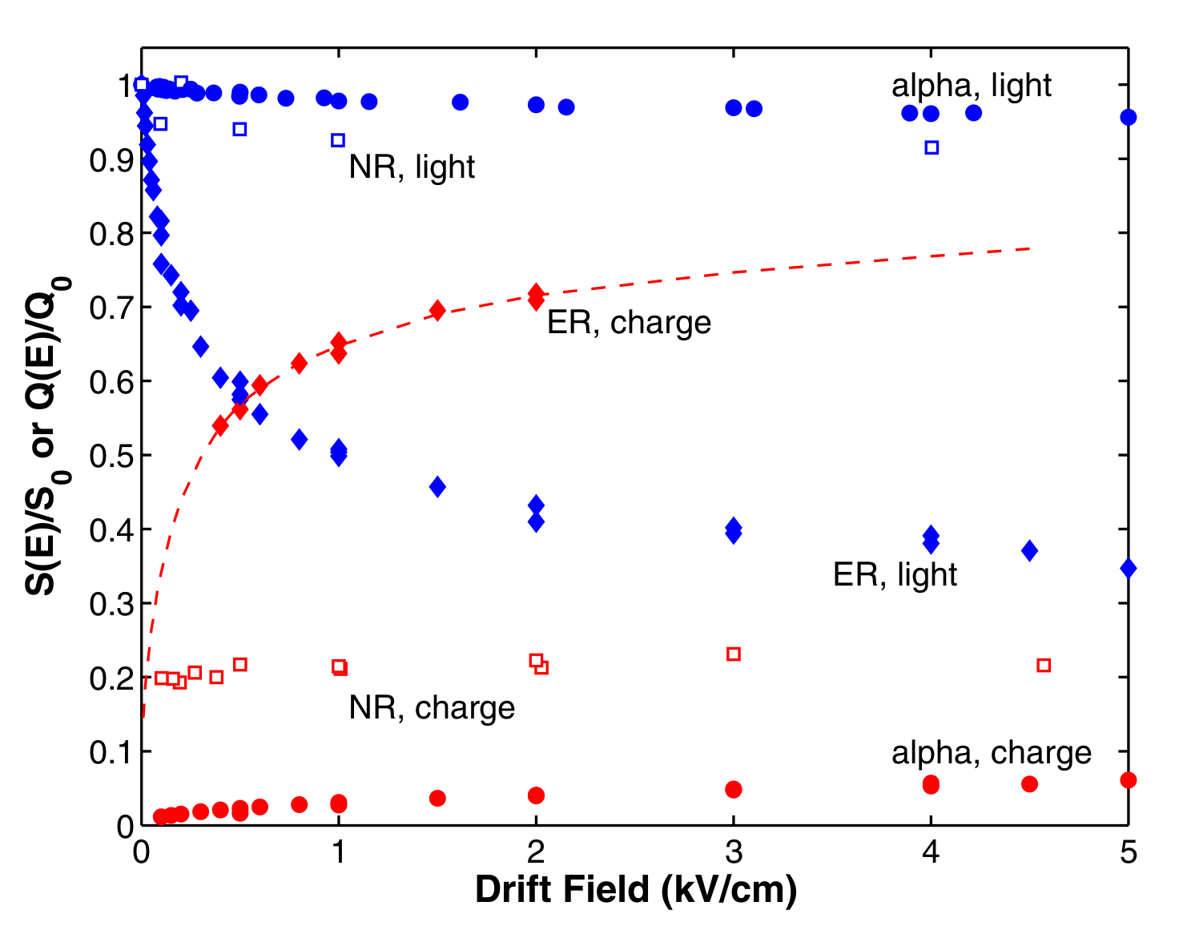
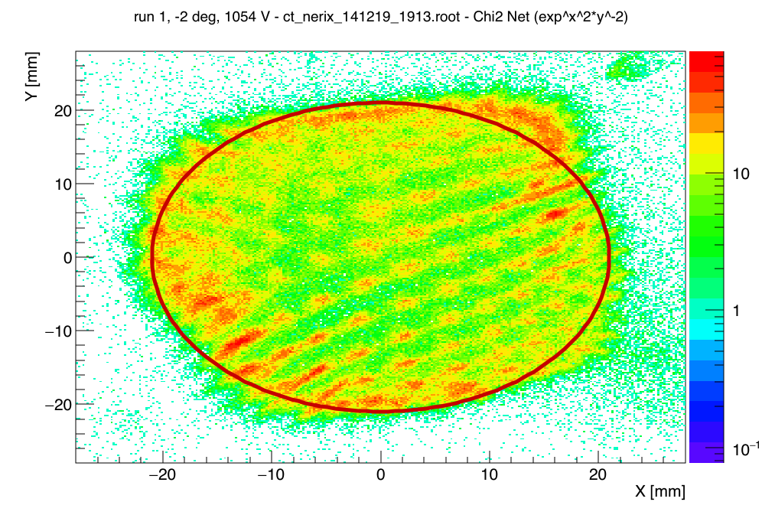
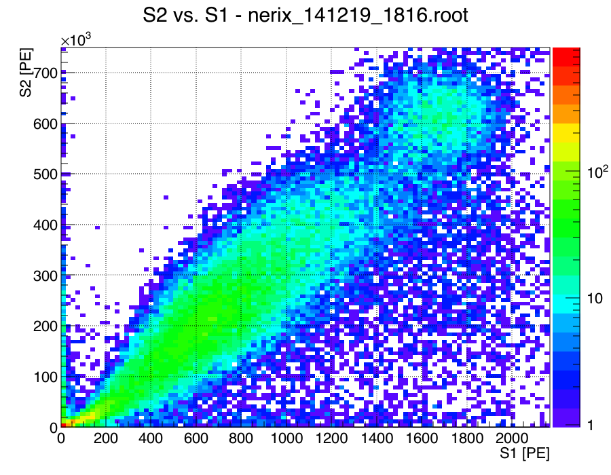
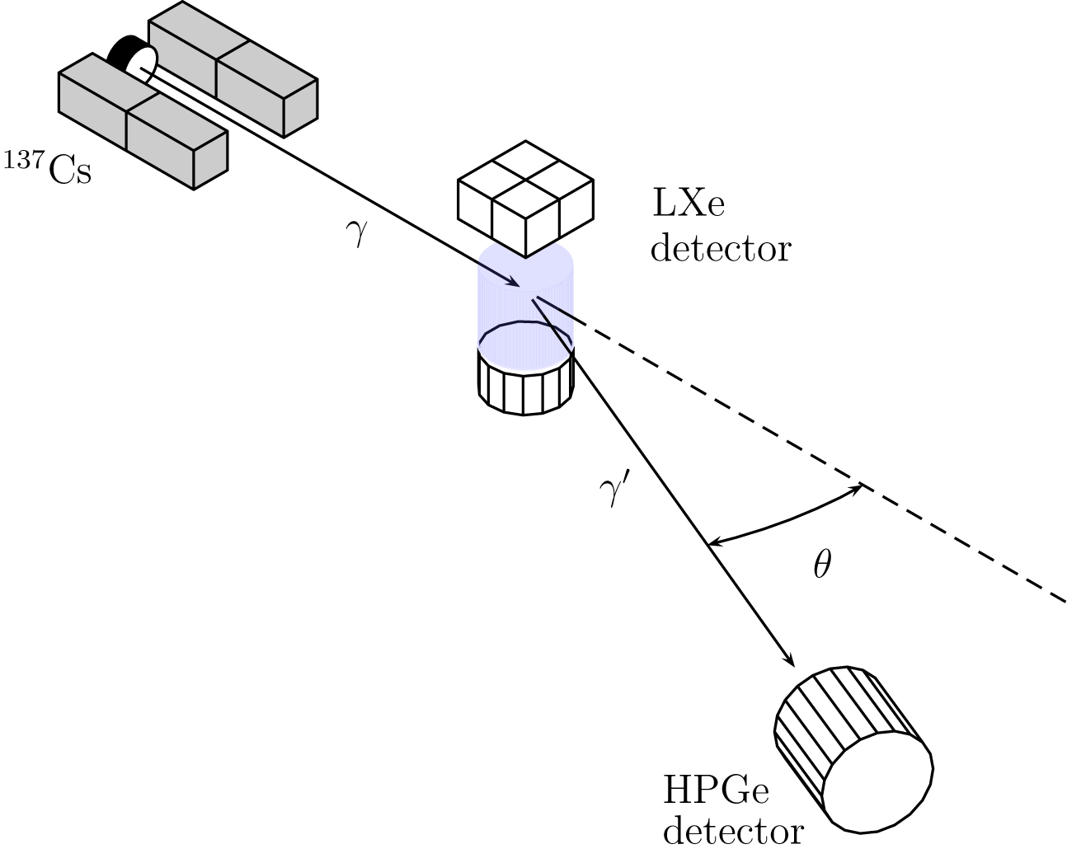
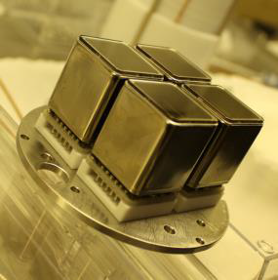
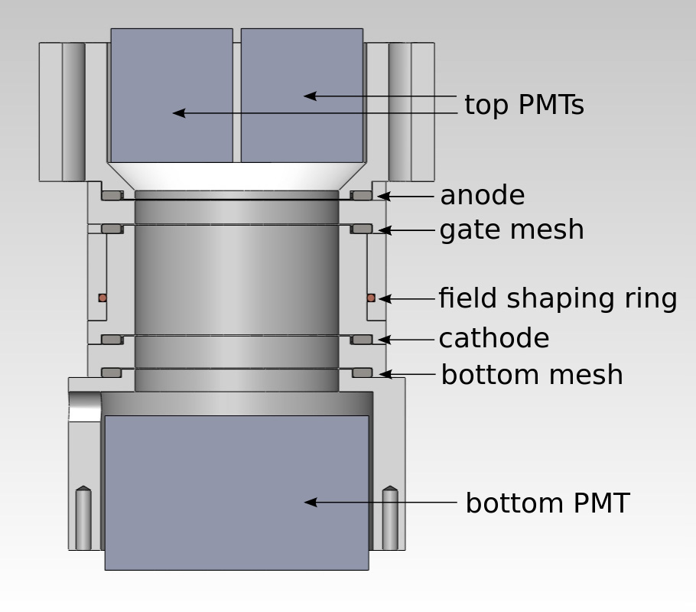
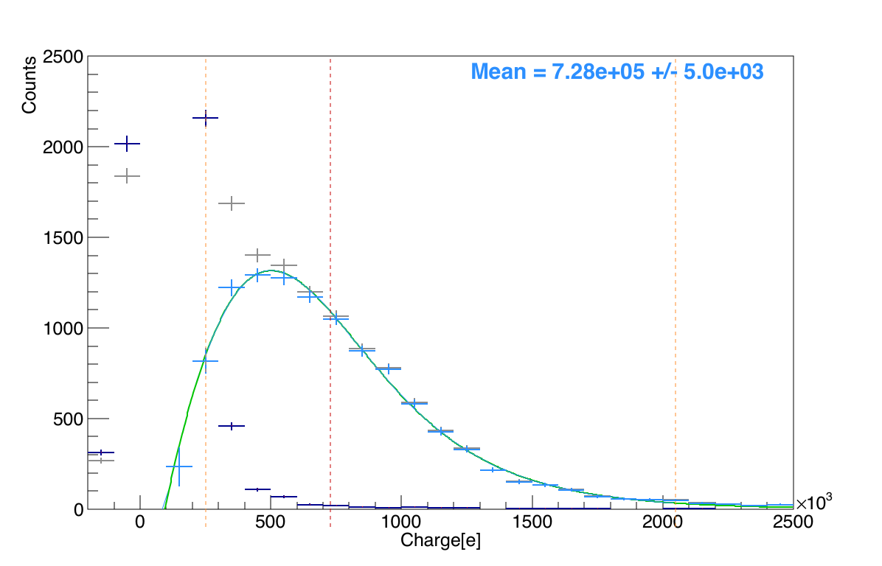
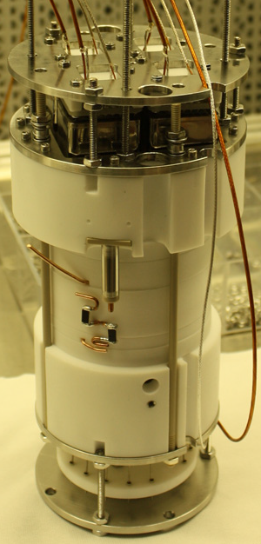
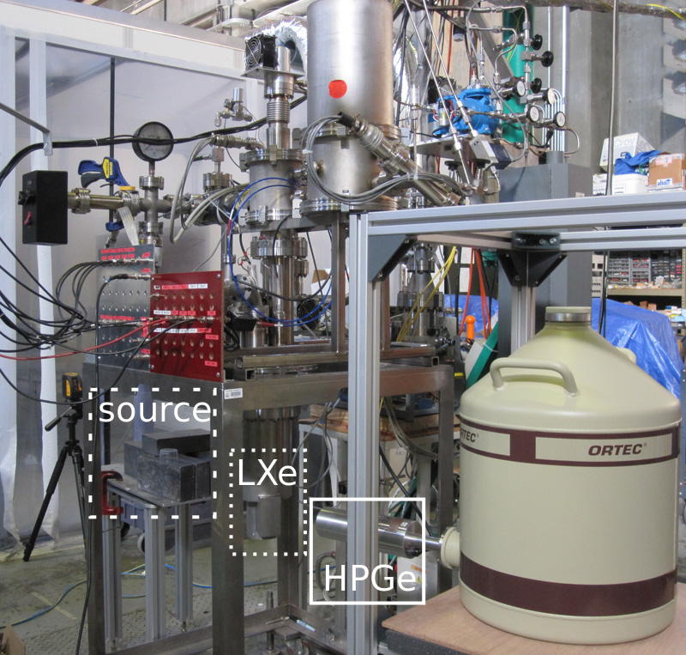
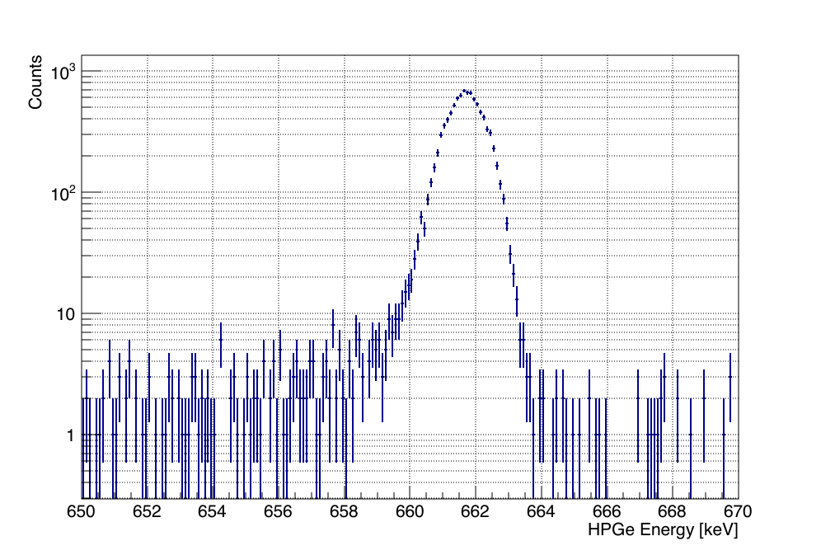
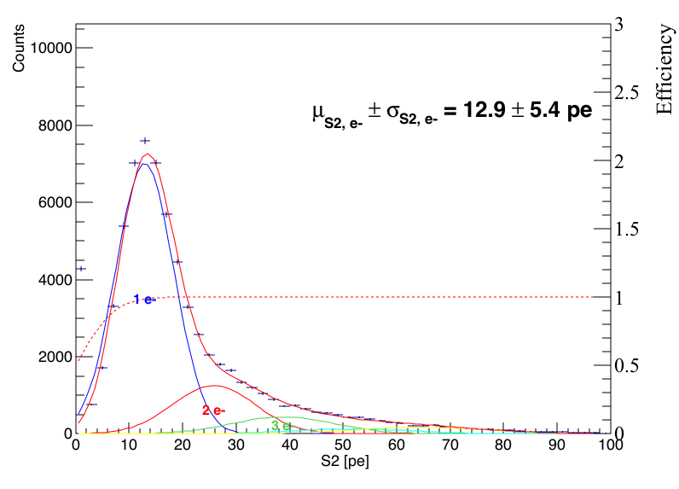
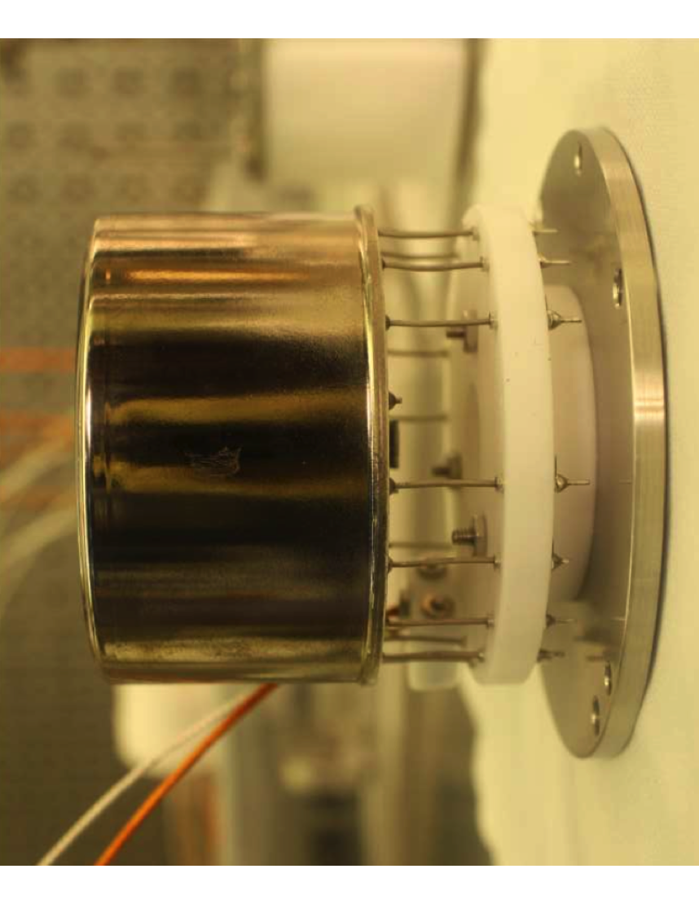
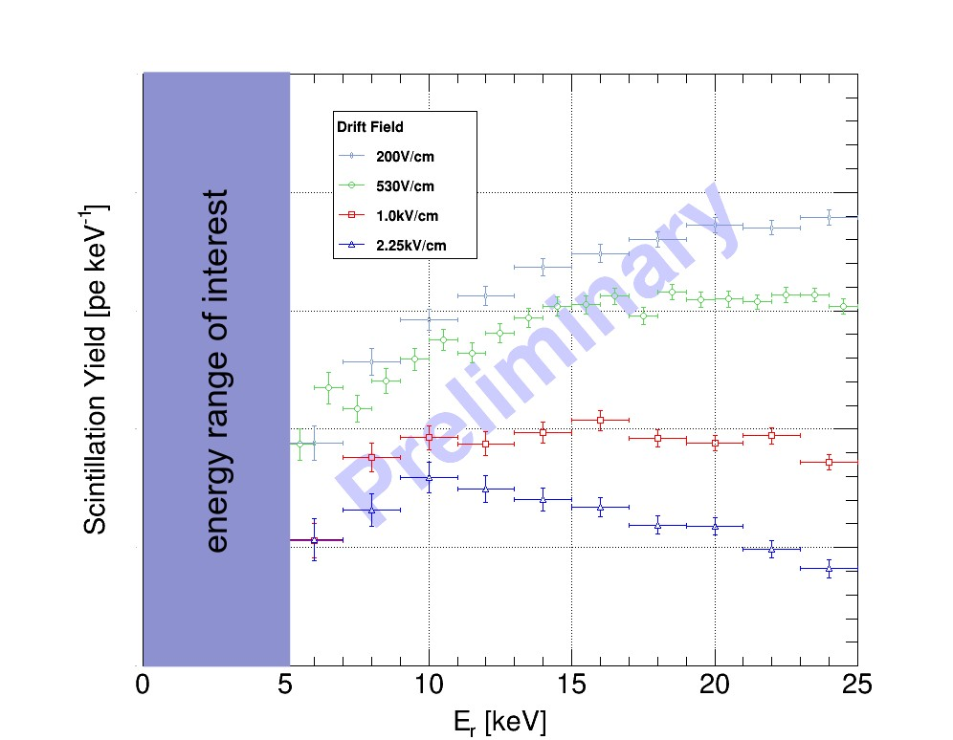
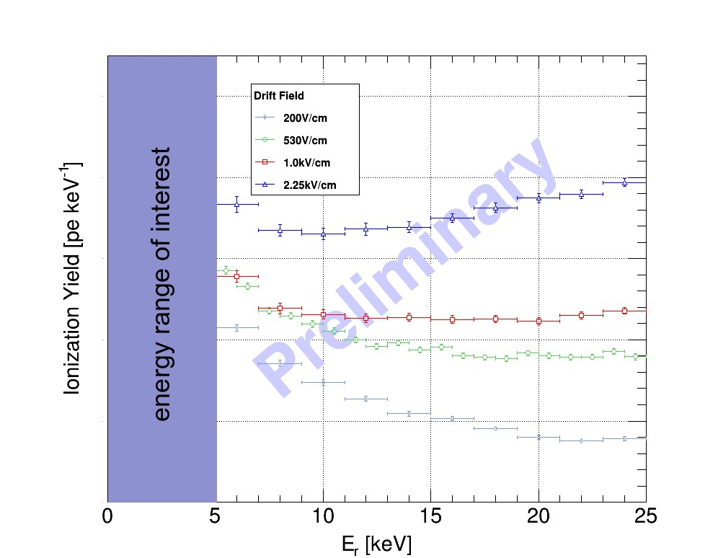


Measurement of the Light and Charge Yield of Low Energy Electronic and Nuclear Recoils in Liquid Xenon for Different Electric Fields
M. D. Anthony, E. Aprile, L. W. Goetzke, G. Plante, and M. Weber
Columbia University, New York, NY
Dual-Phase LXe TPC
Light and Charge Yield
Simultaneous detection of light and charge
S1: Prompt light emission from interaction in LXe
S2: Complementary signal from acceleration of electrons through GXe after electrons drift through LXe
Light and charge yield as a function of energy and drift field unknown at low energies
Light Yield = Photoelectrons / Energy
Charge Yield = Free Electrons / Energy
Light and Charge Yield vs. Drift Field
Leads to S2 if remains free
Aprile et al., 2007 (PRL B)
S1
S1
Given an electronic or nuclear recoil at a certain energy in an electric field, how much light and charge do you expect to be produced?
neriX Detector
Compton Coincidence Technique
Dual-phase Time Projection Chamber for measuring nuclear and electronic recoils in Xenon
Small size and minimal materials surrounding fiducial volume make this detector well suited for measurements of light and charge yield
Can measure light and charge yield as a function of energy and drift field
Goal of neriX is to improve our understanding of low energy interactions in LXe
Position Reconstruction
Photons Compton scatter in LXe then deposit remaining energy in HPGe detector
Cs-137 Spectra in neriX and HPGe
Single Photoelectron Gain
Single Electron Gain
Energy Deposited in LXe vs. Prompt Scintillation Light (S1) - 490 V/cm
Preliminary Electronic Recoil Results
By taking slices of 1-2 keV in the recoil energy vs. S1 and S2 spectra we can determine the light and the charge yield respectively
Expected anti-correlation present
Results shown are preliminary – light and charge yields were both measured down to 1 keV
Light Yield vs. Recoil Energy
Charge Yield vs. Recoil Energy

